Slide 1
Introduction to Android
Session 1
Course : Mobile Community Solution
Effective Period : September 2019

Slide 2
Learning Objectives
At the end of this meeting is expected that students will be able to:
  Explain the Java Programming language concept on Android

Slide 3

Contents
What is Android
Android Architecture
Setting Environment
Build App
Run App
Refining App

Slide 4

What is Android
Android is a mobile operating system that is based on a modified version of Linux.
Developed by Android, Inc. and purchased by Google in 2005.
It’s a powerful development framework that includes everything you need to build great apps using mix java and XML.

Slide 5

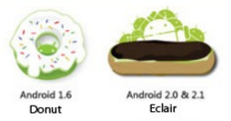







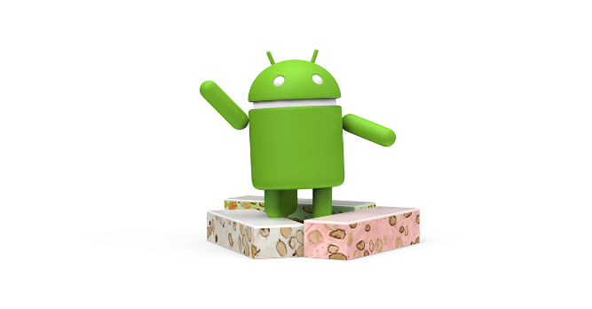



Android Version
Android 1.0 - Release Date: September 23, 2008
Android 1.1 - Release Date: February 9, 2009
Android 1.5 Cupcake – Release Date: April 30, 2009
Android 1.6 Donut - Release Date: September 15, 2009
Android 2.0/2.1 Éclair – Release Date: October 26, 2009
Android 2.2 Froyo (Frozen Yogurt) – Release Date: May 20, 2010
Android 2.3 Gingerbread - Release Date: December 6, 2010
Android 3.0 Honeycomb - Release Date: February 22, 2011
Android 4.0 Ice Cream Sandwich - Release Date: October 19, 2011
Android 4.1 Jelly Bean - Release Date: July 9, 2012.
Android 4.4 Kit Kat – Release Date: October 31, 2013.
Android 5.0 Lollipop – Release Date: November 12, 2014.
Android 6.0 Marshmallow – Release Date: October 5, 2015.
Android 7.0 Nougat – Release Date: August 22, 2016.
Android 8.0 Oreo – Release Date: August 21, 2017.
Android 9.0 Pie – Release Date: August 6, 2018

Slide 6
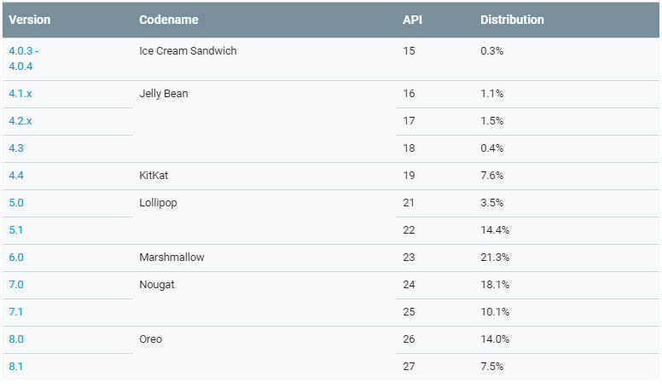
Android Distribution

Slide 7
Android Architecture
The Android OS is roughly divided into five sections in four main layers:
Linux Kernel
Libraries
Android Runtime
Application Framework
Applications

Slide 8
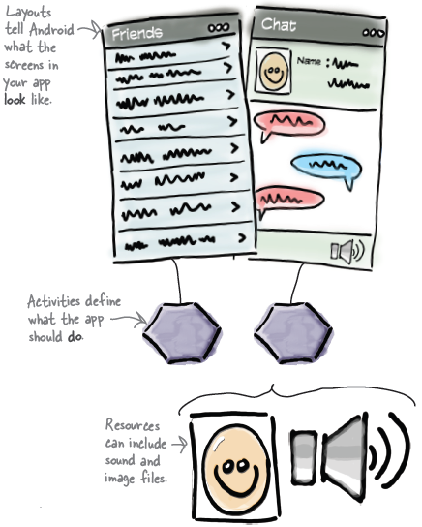
What makes up a typical Android App?

Slide 9
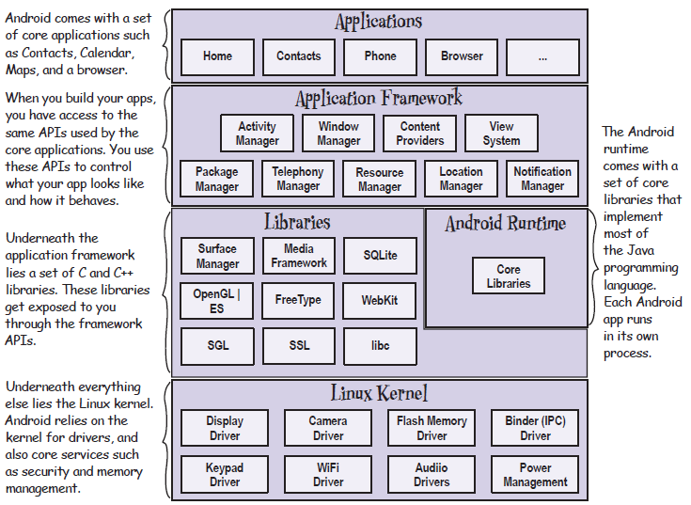
Android Architecture

Slide 10
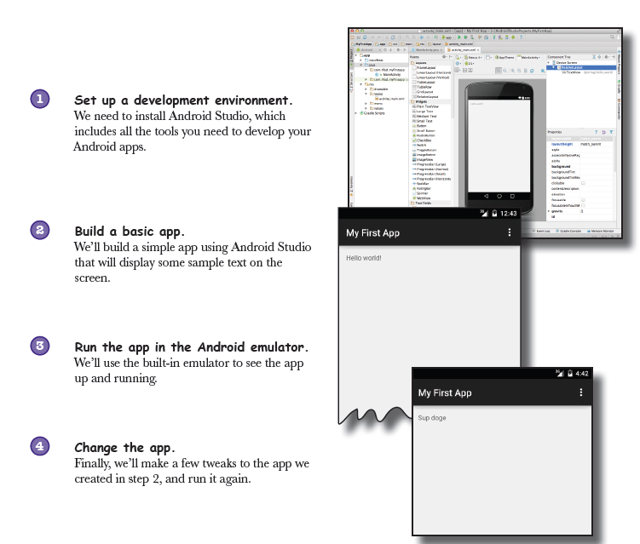
What are we’re going to do?

Slide 11
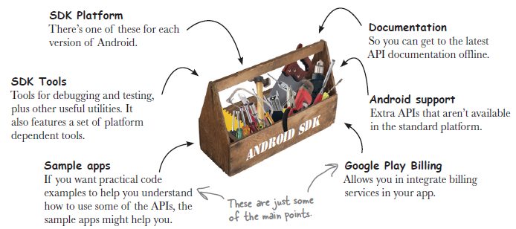
Getting Started – Set Up Environment
The Android SDK

Slide 12
Getting Started – Set Up Environment
Android Studio is a special version of IntelliJ IDEA
  IntelliJ IDEA is one of the most popular IDEs for Java Development.
  Android Studio is a version of IDEA
  Android studio is Java development environment, so make sure the right java is installed on your machine.
  First, check android studio requirement of which Java Development Kit (JDK) and Java Runtime Edition (JRE).
  http://developer.android.com/sdk/index.html#Requirements
  Get them and install
  http://www.oracle.com/technetwork/java/javase/downloads/index.html
Install Java

Slide 13
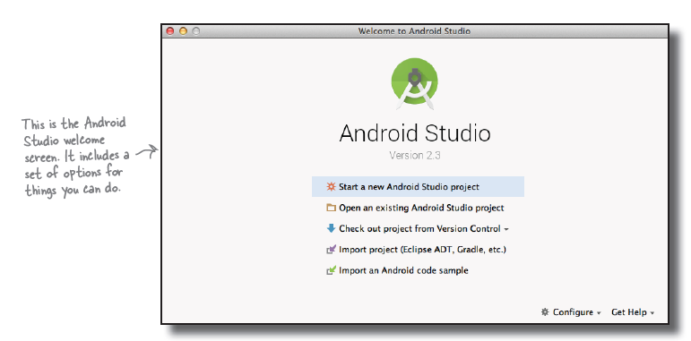
Getting Started – Set Up Environment
Then install Android Studio
https://developer.android.com/sdk/installing/index.html?pkg=studio

Slide 14
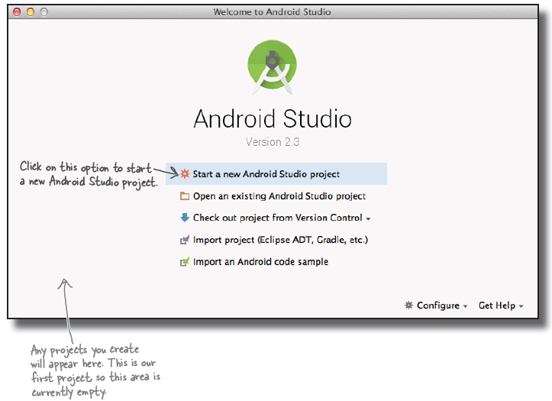
Getting Started – Build App
1. Create a new Project

Slide 15
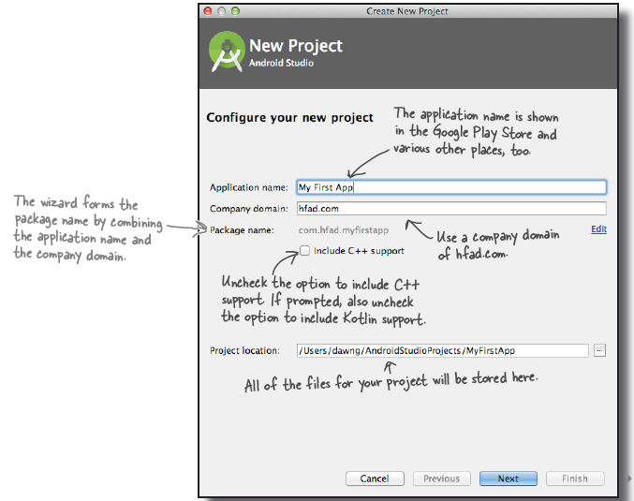
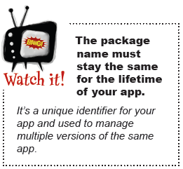
Getting Started – Build App
2. Configure the Project

Slide 16
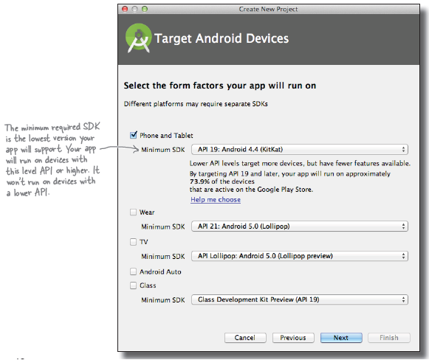
Getting Started – Build App
3. Specify the API Level

Slide 17
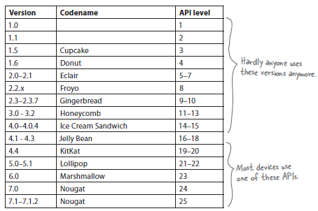
API Level for Android Version
If you specify that your app is only compatible with the very latest version of the SDK, you might find that it can’t be run on many devices in the first instance.

Slide 18
Getting Started – Build App
Activity and Layout
An activity is a single, defined thing that your user can do. Activities are usually associated with one screen, and they’re written in java.
Activities define actions.
A layout describes the appearance of the screen. Layouts are written as XML files and they tell Android how the different screen elements are arranged.
Layout define how the user interface is presented.

Slide 19
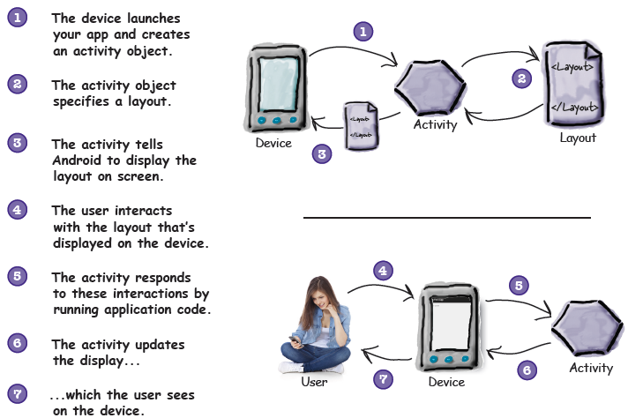
Getting Started – Build App
Activity and Layout

Slide 20
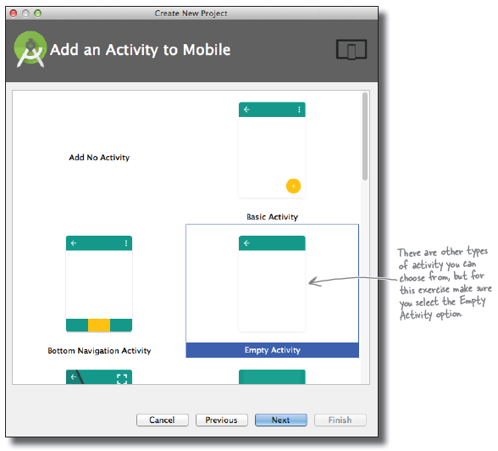
Getting Started – Build App
4. Create an Activity

Slide 21
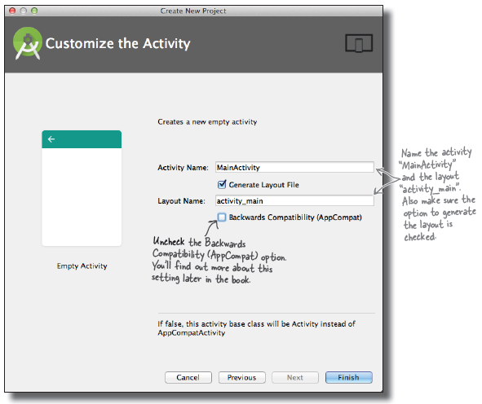
Getting Started – Build App
5. Configure the Activity
The activity is a Java class, and the layout is an XML file, so the names we’ve given here will create a Java class file called MainActivity.java and an XML file called activity_main.xml.

Slide 22
What Just Happened?
The Android Studio wizard created a project for your app, configured to your specifications.
It created a basic activity and layout with template code.

Slide 23
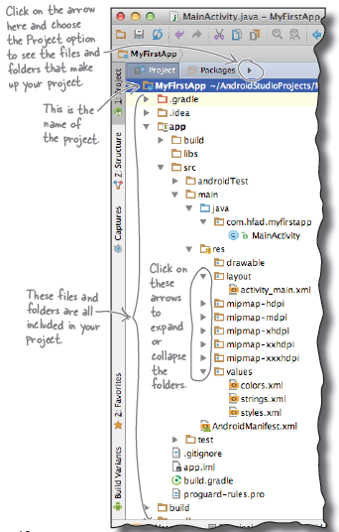
A complete Folder Structure

Slide 24
The Folder Structure
Java and XML Files
These are the activity and layout files the wizard created for you.
Android-generated Java Files
There are some extra Java files you don’t need to touch which Android Studio generates for you automatically.
Resources Files
These include default image files for icons, styles your app might use, and any common String values your app might want to look up.
Android Libraries
In the wizard, you specified the minimum SDK version you want your app to be compatible with. Android Studio makes sure it includes the relevant Android libraries for this version.
Configuration Files
The configuration files tell Android what’s actually in the app and how it should run.

Slide 25
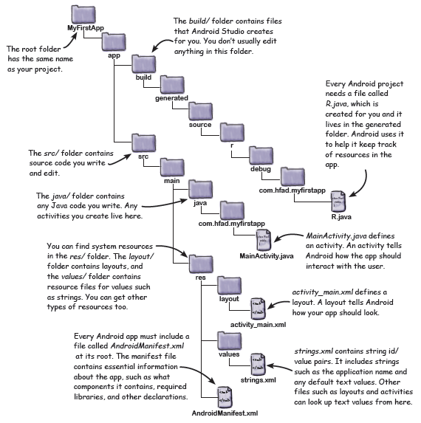
Useful Files in Your Project

Slide 26
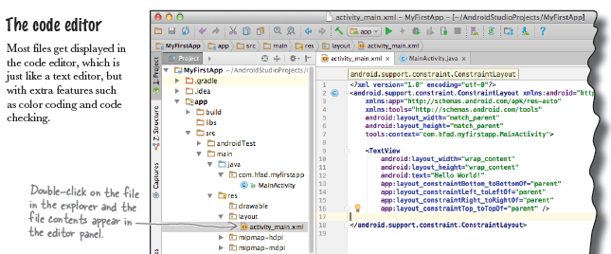
Edit Code

Slide 27
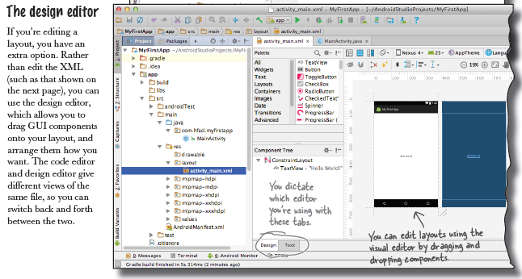
Edit Code

Slide 28
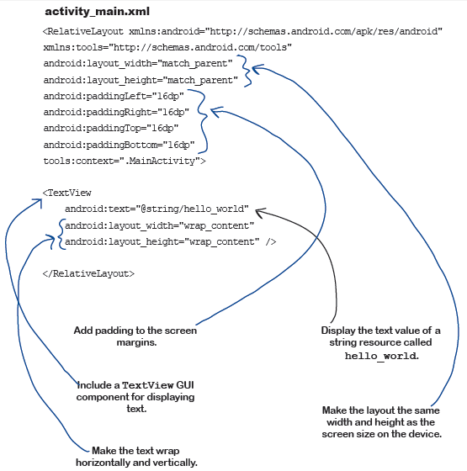
Activity_main.xml

Slide 29
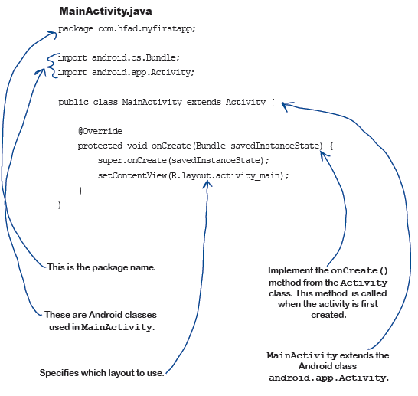
MainActivity.java

Slide 30
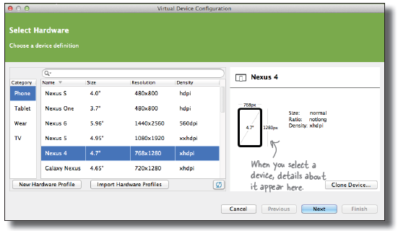
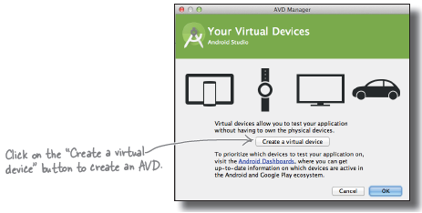
Getting Started – Run App
1. Open AVD and Select the Hardware
The Android emulator allows you to run your app on an Android Virtual Device (AVD).
AVD behaves just like physical Android device.
You can set up numerous AVDs,each emulating a different type of devices.

Slide 31
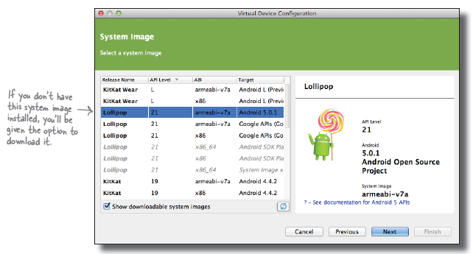
Getting Started – Run App
2. Creating an AVD
Select a system Image

Slide 32
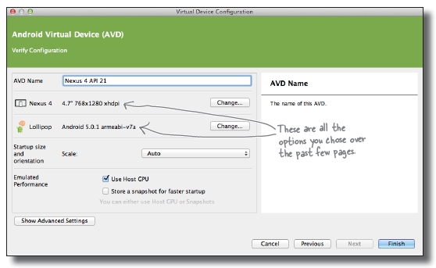
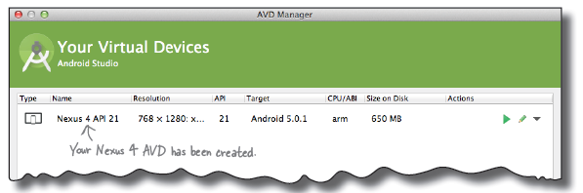
Getting Started – Run App
2. Creating an AVD
Verify the AVD configuration

Slide 33

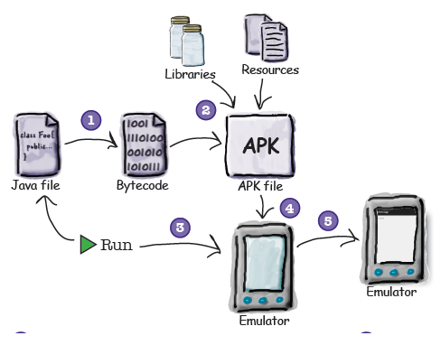
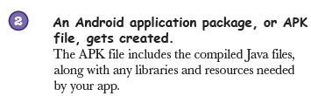



Getting Started – Run App
3. Compile, Package, Deploy, and Run
An APK File is an application package. It’s basically a JAR or ZIP file for android application.

Slide 34
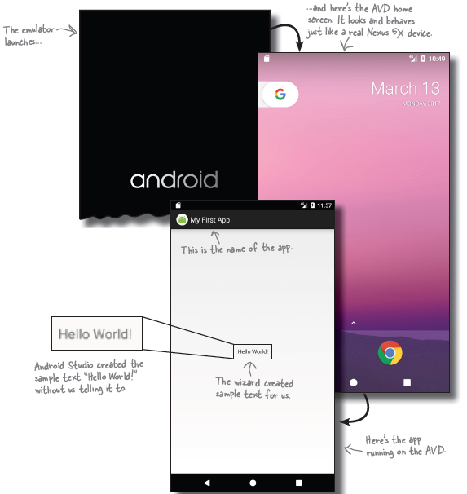
Getting Started – Run App
4. Test Drive

Slide 35
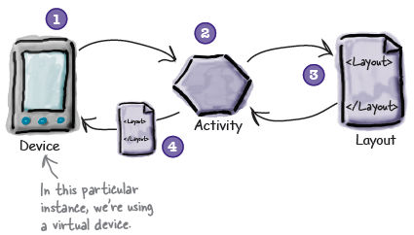

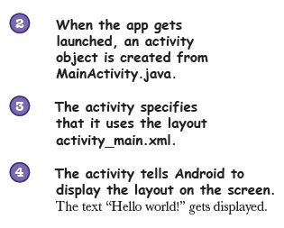
Getting Started – Run App
4. Test Drive (Cont.)

Slide 36
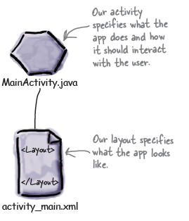
Getting Started – Refining App
The app has one activity and one layout

Slide 37
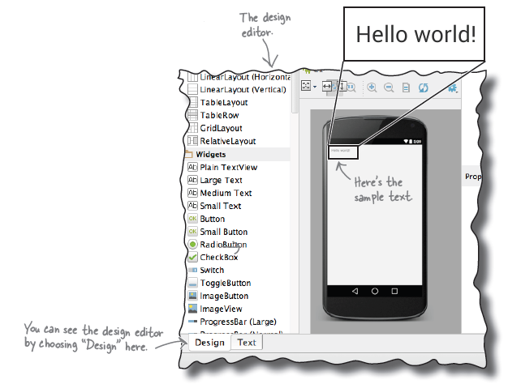
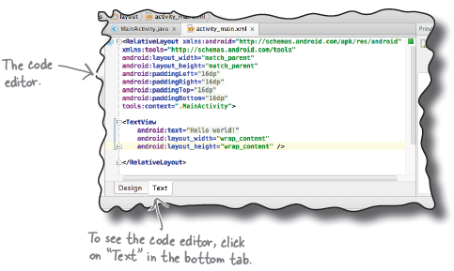
Getting Started – Refining App
What's in the Layout?
There are two ways of viewing and editing layout files in Android studio through the code editor and design editor

Slide 38
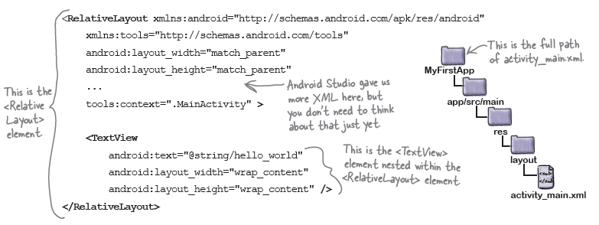
Getting Started – Refining App
Activity_main.xml has 2 Elements

Slide 39
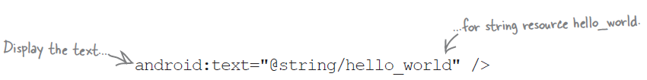
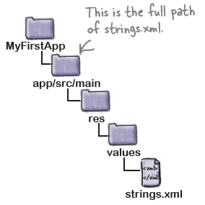
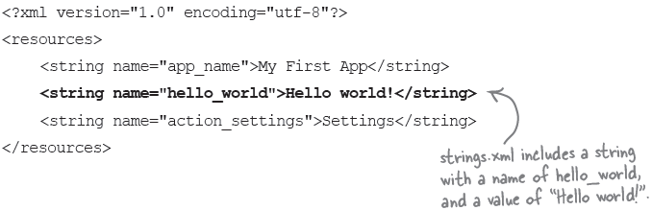
Getting Started – Refining App
Strings.xml
Put string values in string.xml rather than hardcoding them.
String.xml is a resource file used to hold name/ value pairs of strings.

Slide 40
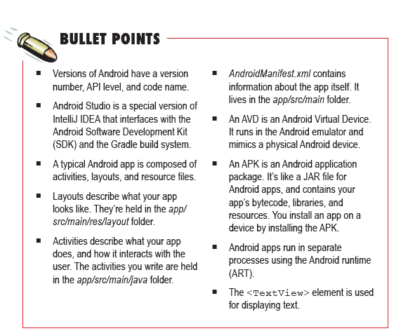
Summary

Slide 41
References
Head First Android Development. 2nd Edition. A Brain friendy guide. Dawn Griffiths and David Griffiths.O’reilly. ISBN:978-1-491-97405-6. Chapter 1
https://developer.android.com/

